Slide 1
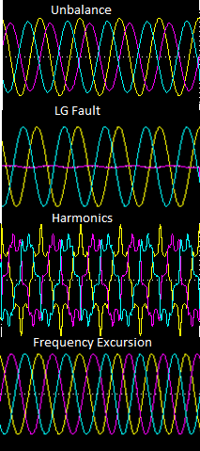
The design and performance optimization of 3-phase PLLs for phase tracking under grid imperfections
Mentor: Dr. C. Nagamani
Pradhyumna R. 107108077
Sambhav R Jain 107108103
Objective:
Phase tracking
Depth of work:
Detailed analysis of 4 PLL schemes in literature (SRF, DDSRF, DSOGI, MCCF)
Mathematical modeling
Simulation to match results from literature
Intuitive plot program for comparison between schemes
Novel loop filter design
Self-consistent model based approach
Comparisons of existing design schemes with the proposed scheme
Development of a 3D lookup table
Experimentation (in progress)

Slide 2
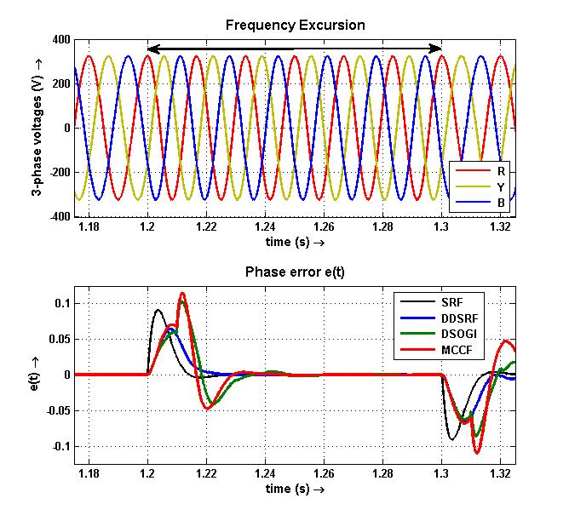
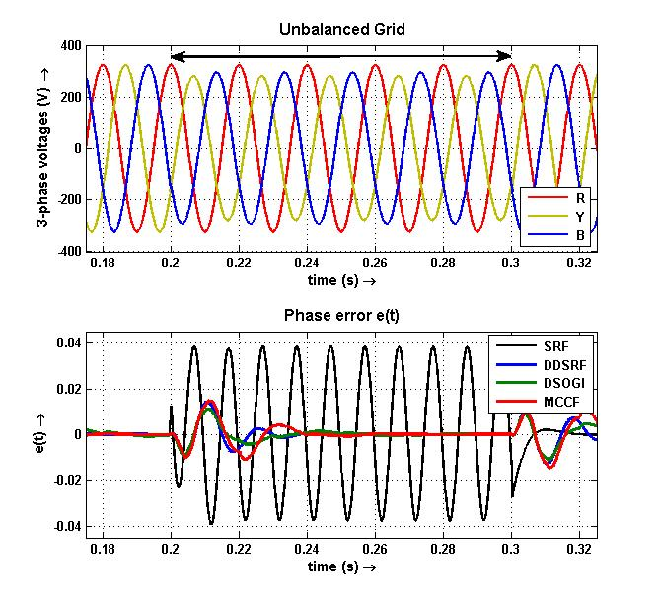
Detailed analysis of 4 PLL schemes in literature
PLL schemes developed: SRF, DDSRF, DSOGI, MCCF
SRF – Synchronous Reference Frame PLL
DDSRF – Decoupled Double Synchronous Reference Frame PLL
DSOGI – Dual Second Order Generalized Integrator based 3-phase PLL
MCCF – Multiple Complex Coefficient Filter based 3-phase PLL
Comprehensive Simulink models
Intuitive plot program (at least 200 comparisons possible!!)

Slide 3
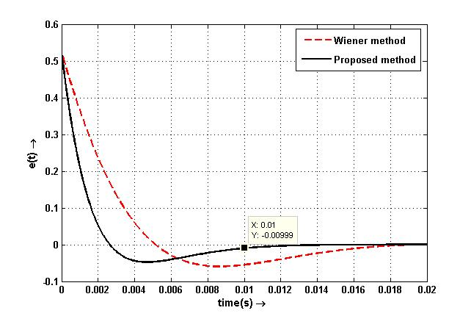
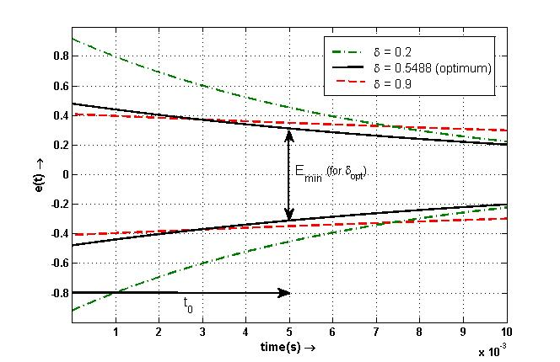
Novel loop filter design
Need: decoupling of dynamic performance and filtering characteristic
Error quantization
Newton
Raphson
ω_{n}
δ
Damping optimization
Cardan’s
Analytical
Solution
Gives a unique set of loop filter parameters k_{p} and k_{i} - no trial and error

Slide 4
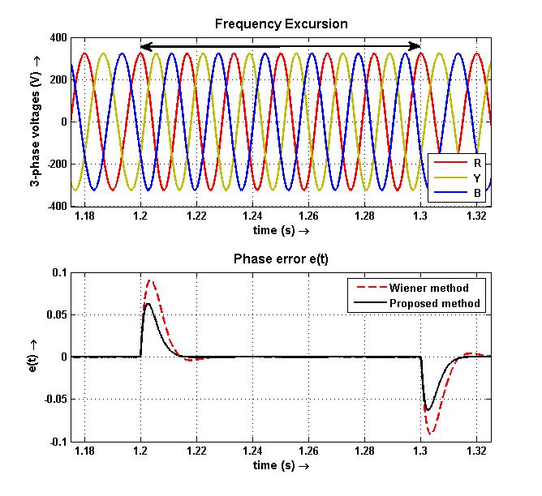
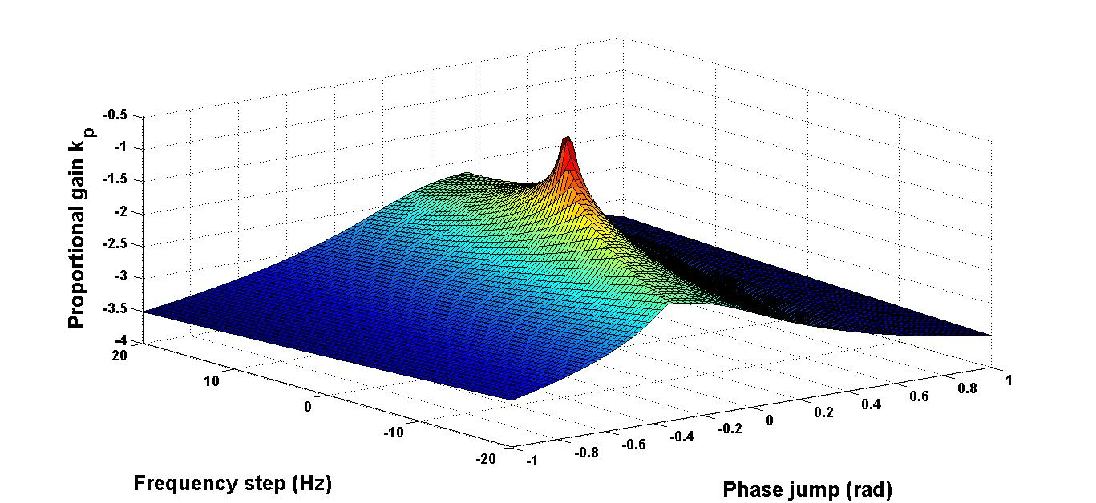
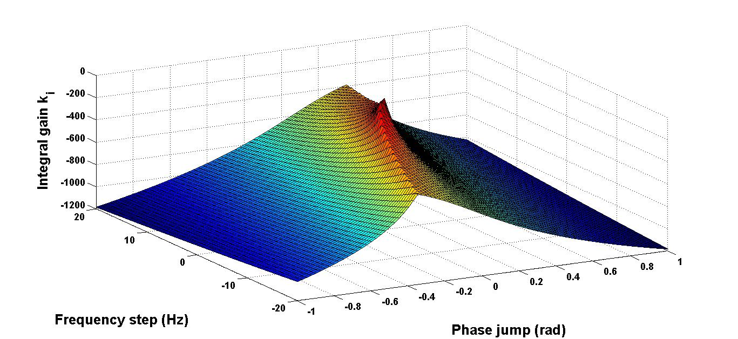
Novel filter design (continued)
Comparisons with Wiener method
Better dynamic performance
Extremely convenient from user’s perspective
Development of a 3D lookup table
Theoretical aspect:
Can be used as an educational tool to make notable inferences
Practical aspect:
Eliminate constraints on the speed and computing power of the micro-controller/ DSP
3D lookup table: k_{p}
3D lookup table: k_{i}

Slide 5
Conclusions
Analysis and in-depth understanding of 4 existing PLL schemes
Development of a generalized software applet
Excellent learning tool
Easy to use
To find out which scheme tackles a particular issue better
Additions of other schemes (if required) can be easily done
Novel self-consistent model based loop filter design
No trial and error as a unique (k_{p} , k_{i}) pair for a particular grid condition
Both error and damping is optimized
3D lookup table for easy hardware implementation
Hardware implementation
MSP430 Launchpad is used and the ADC and PWM modules are interfaced
Yet to create a frequency excursion to test the SRF PLL implementation
Future work
Use of the 3D lookup table for re-configurable filter design
Hardware testing of the proposed design on the other PLL schemes

Slide 6
Thank you

Slide 7
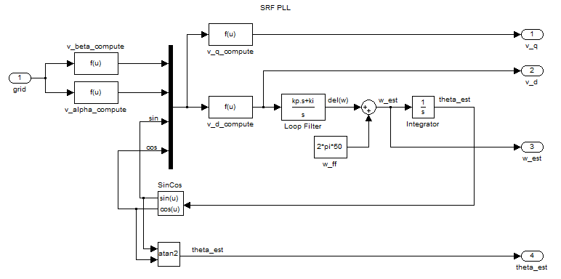
Conventional SRF PLL
Back

Slide 8
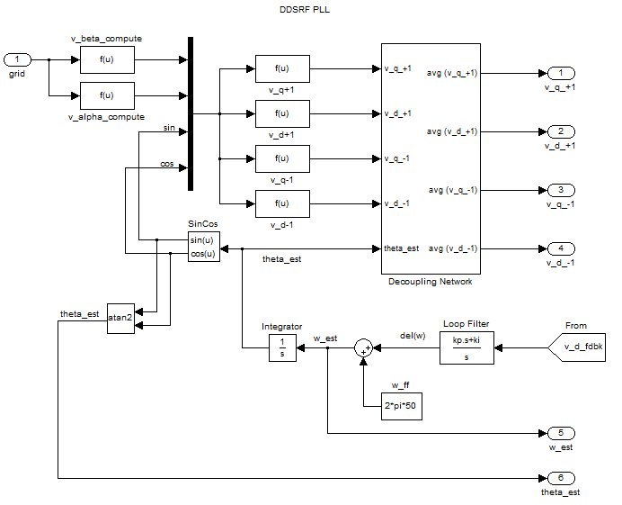
DDSRF PLL
Back

Slide 9
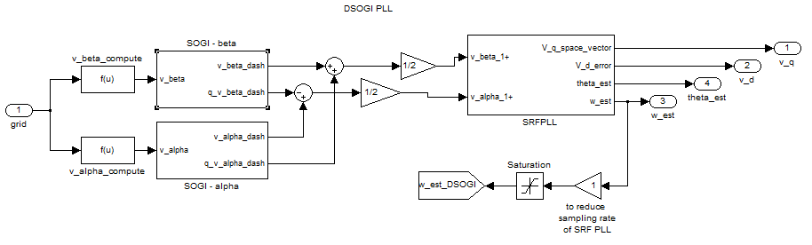
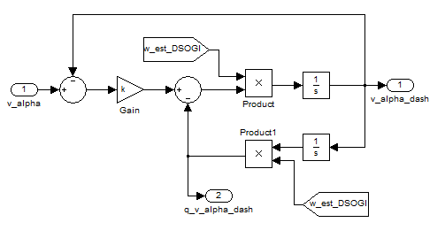
DSOGI PLL
Back

Slide 10
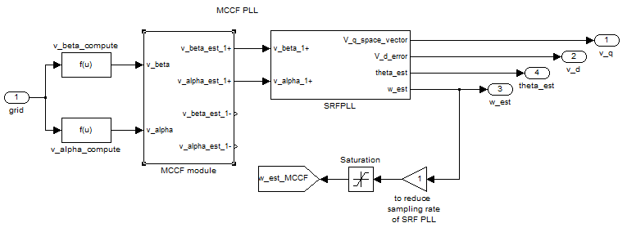
MCCF PLL
Back

Slide 11
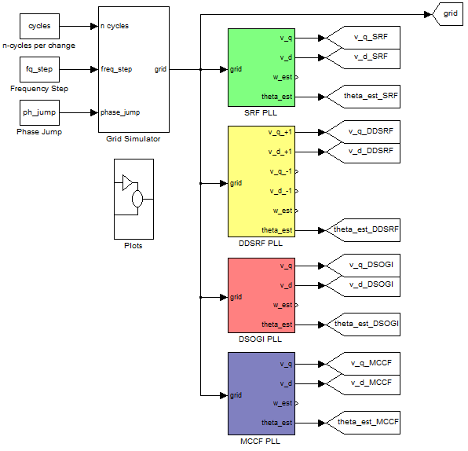
4 PLLs simulated on a single model

Slide 12
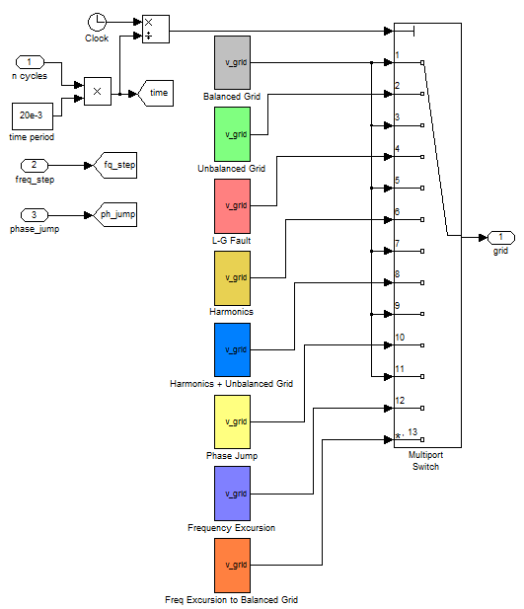
The grid simulator used to create imperfect grid conditions
Back

Slide 13
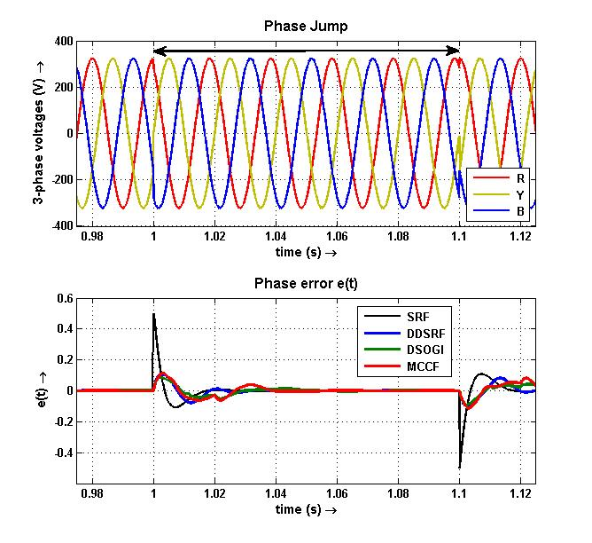
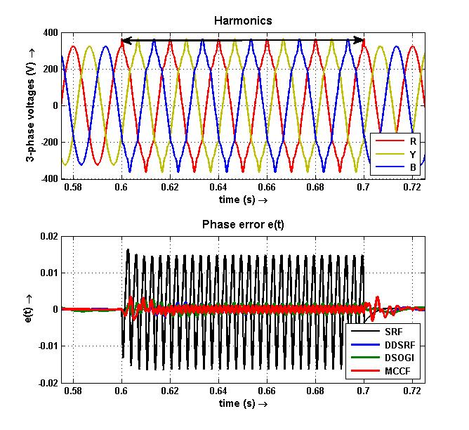
Intuitive plot program results
Back

Slide 14
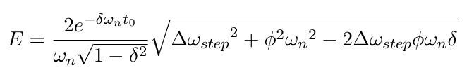
Error quantization
Back

Slide 15
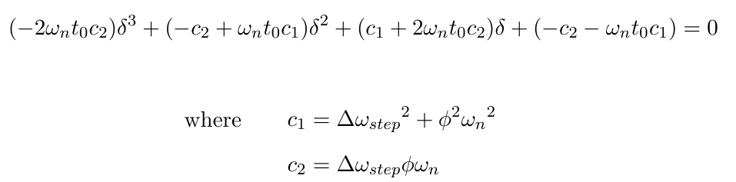
Damping optimization
Back

Slide 16
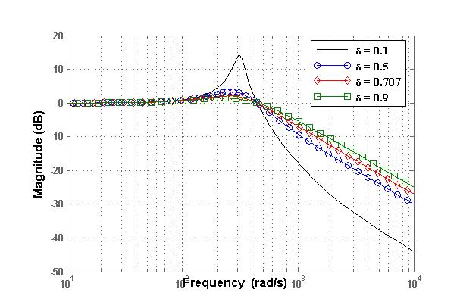
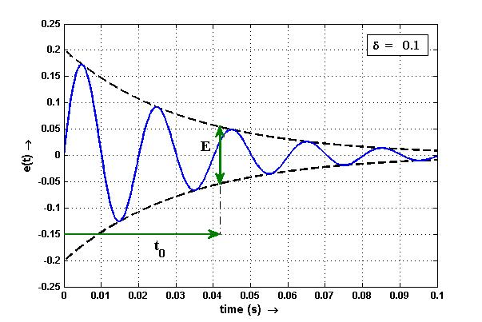
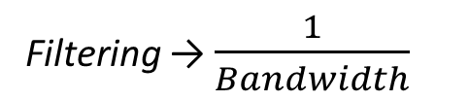
Filtering characteristic v/s Dynamic response
Back
Filtering → $\frac{1}{Bandwidth}$
Dynamic performance → Bandwidth
Wiener method: good trade-off between filtering and dynamic response
Proposed method: focus is on dynamic response

Slide 17
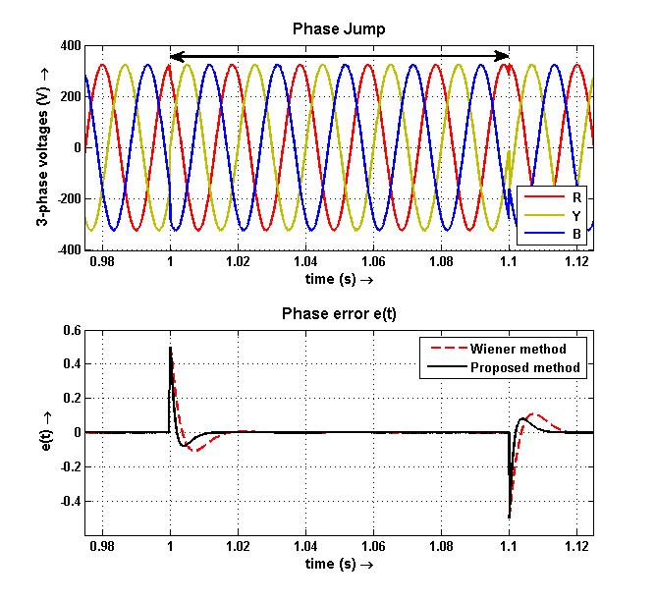
Comparisons – SRF PLL on phase jump

Slide 18
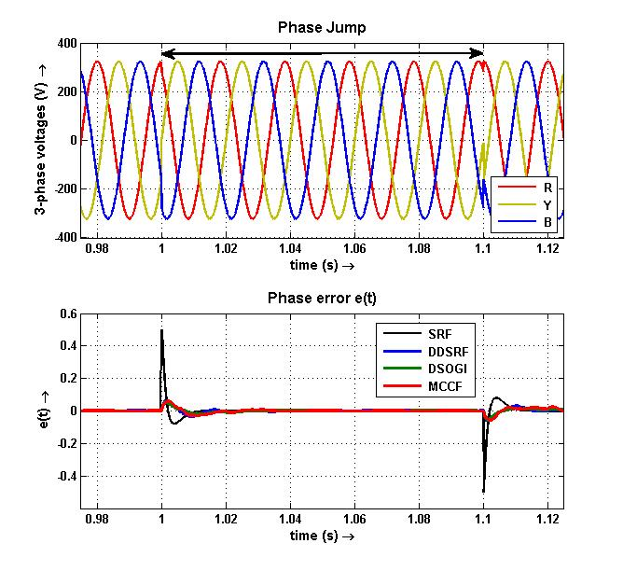
Comparisons
Back
Wiener method
Proposed method

Slide 19
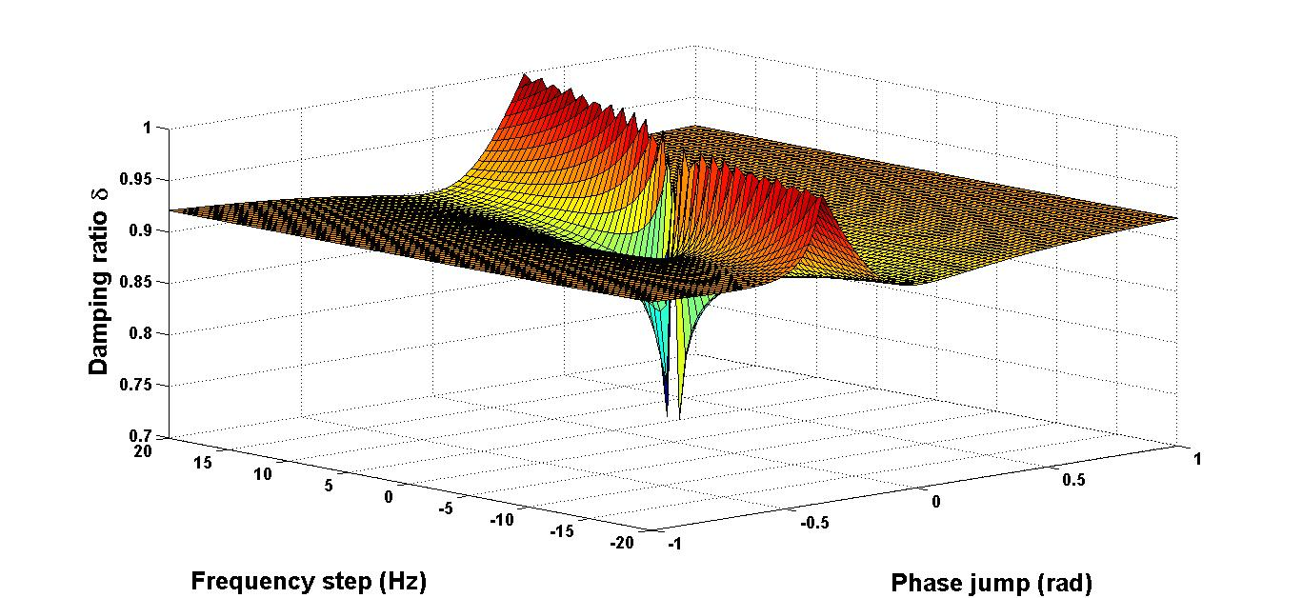
3D lookup table – optimized δ

Slide 20
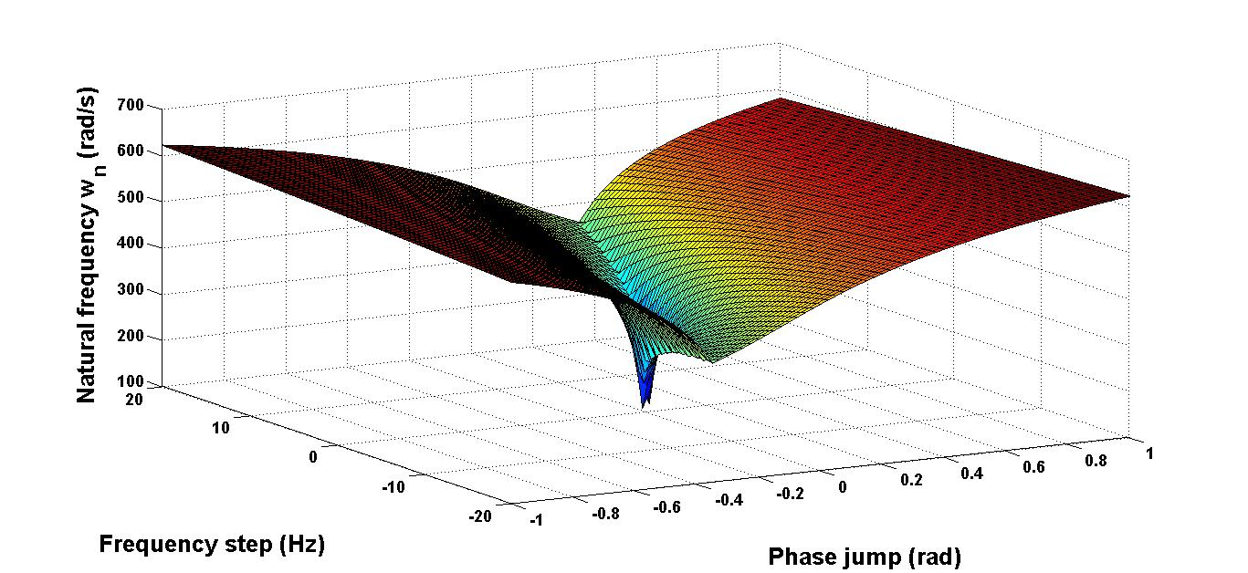
3D lookup table – optimized ω_{n}

Slide 21
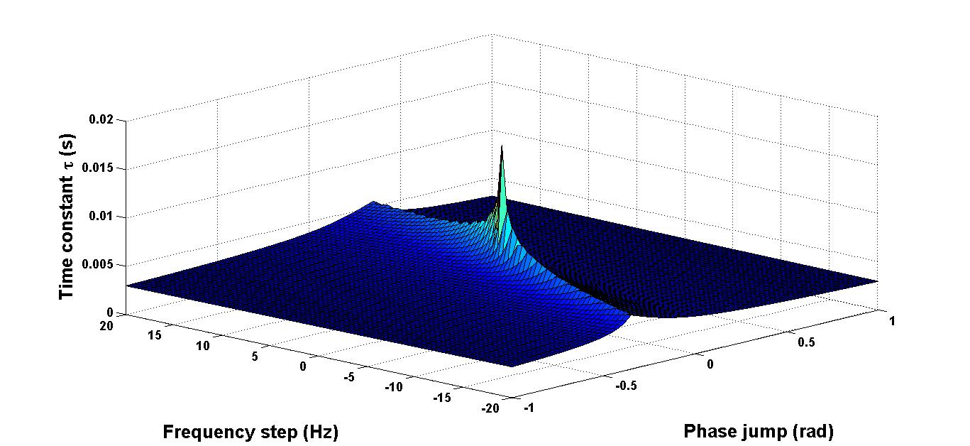
3D lookup table – optimized τ
Back

